Slide 1

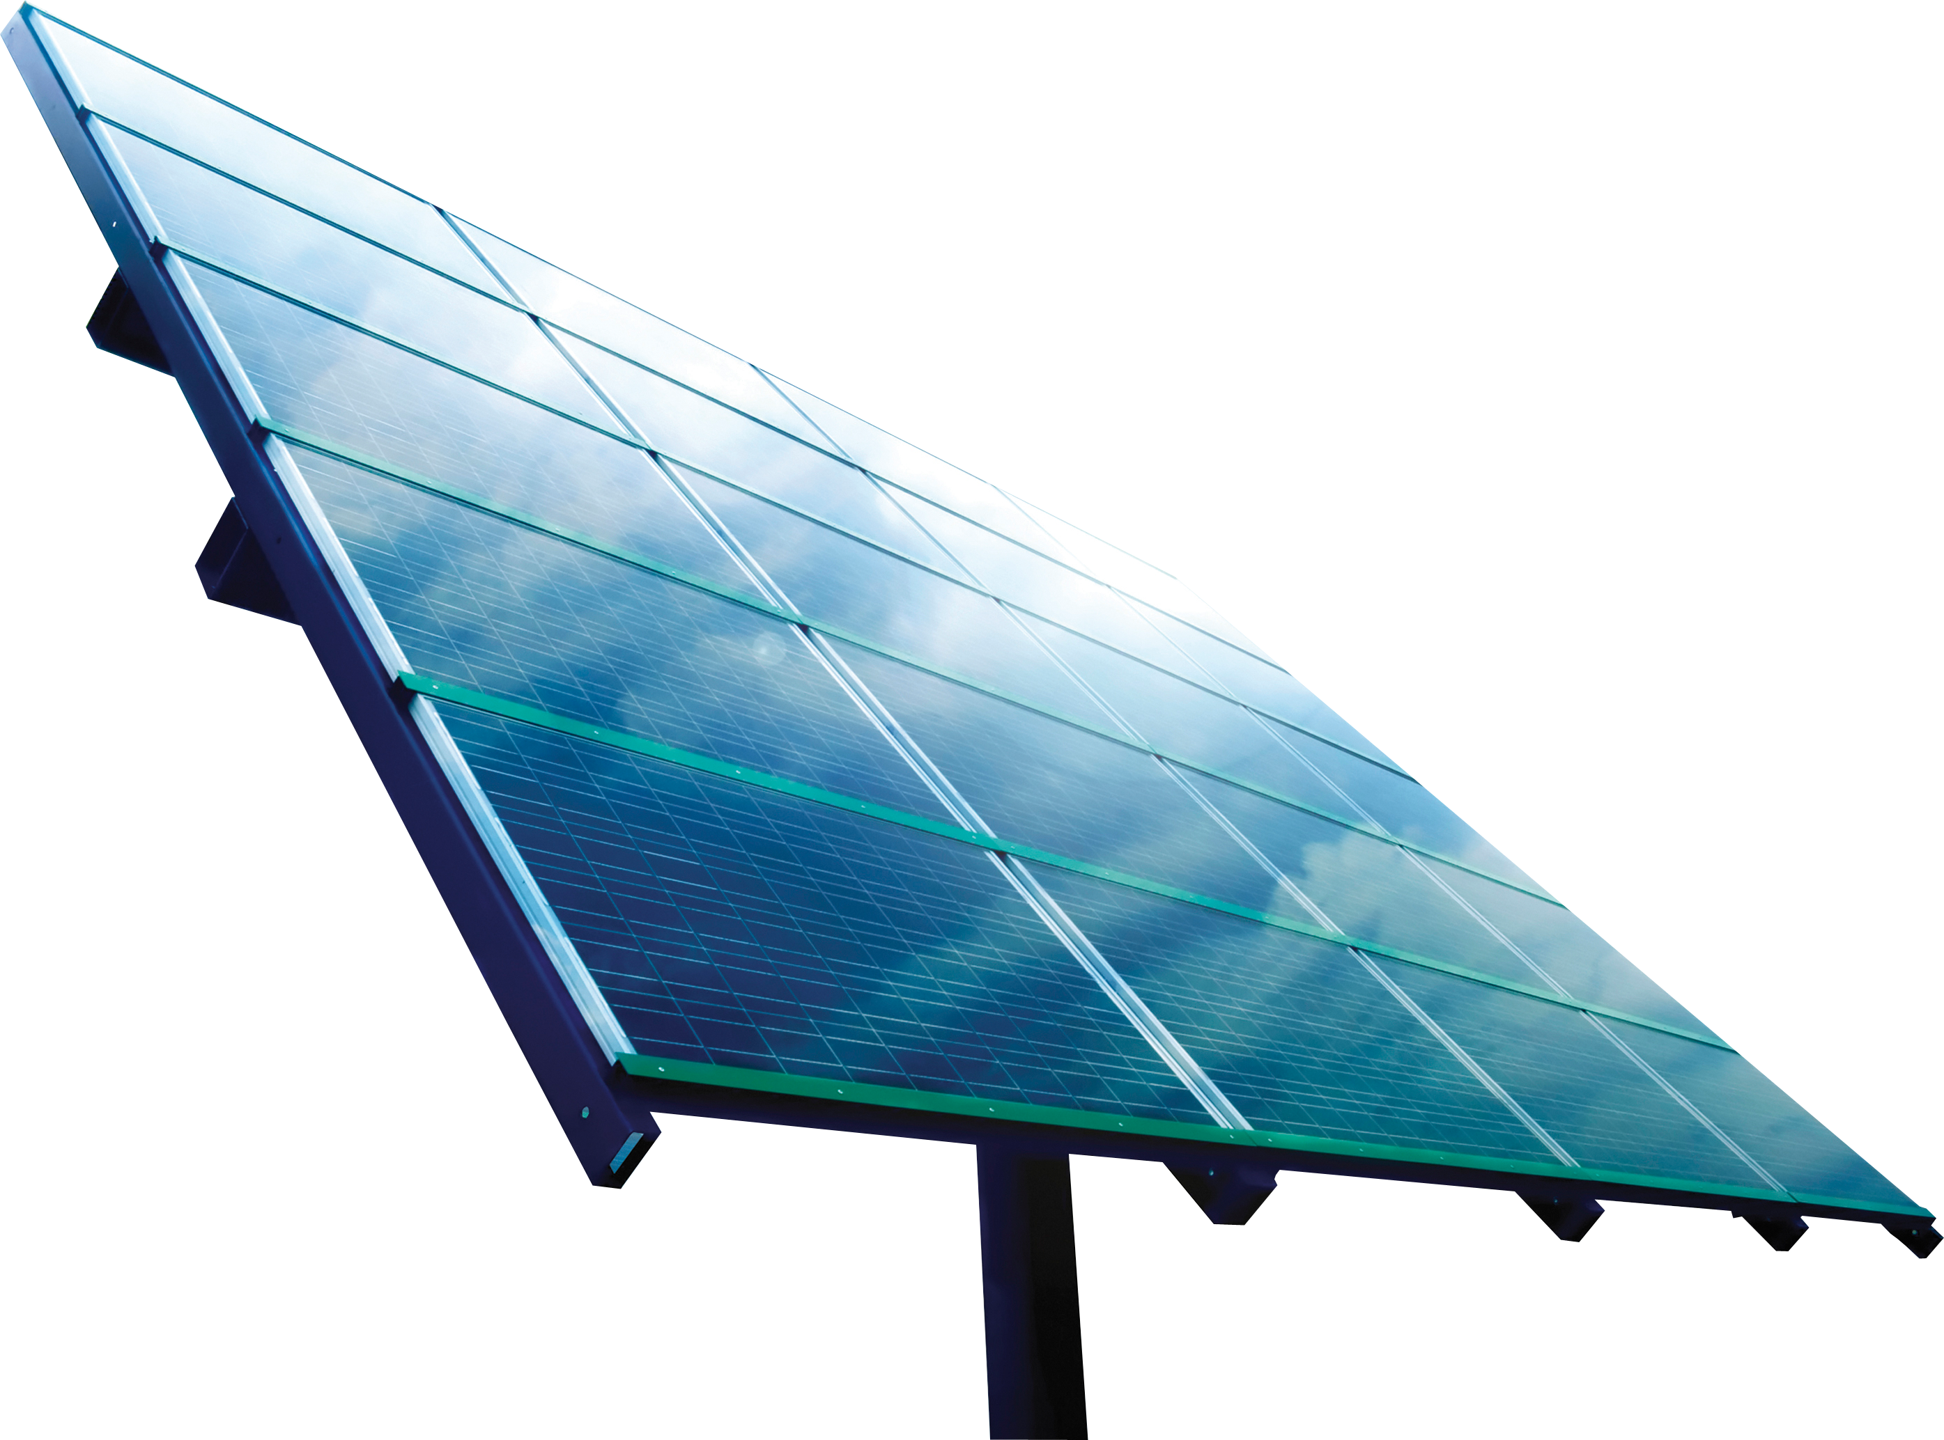
Sun Tracking Solar Panel
Made By
Vardaan Sharma(2100910310168)
Vipul Jain(2100910310171)
Sambhav Saxena(2100910310121)
Sahil Khan(2100910310118)
Image Source URL-https://www.freeiconspng.com/img/48199,https://www.pngegg.com/en/png-tavkh

Slide 2
Our Mentor's
Rakesh Sir And Pooja Mam

Slide 3
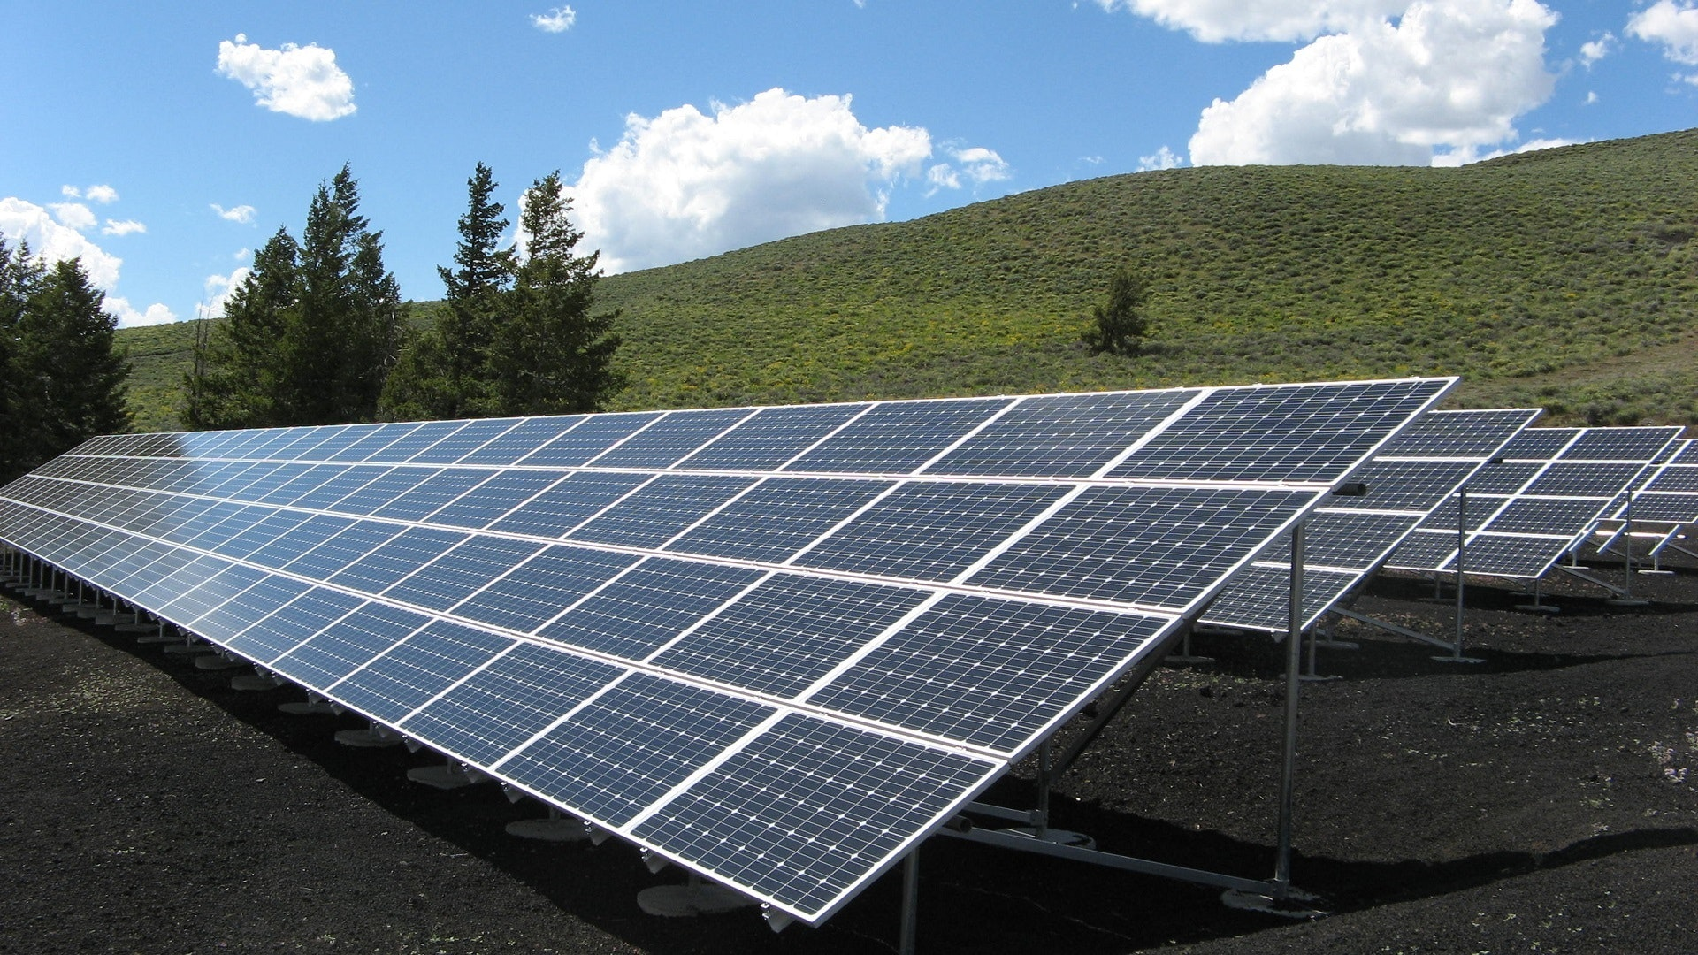
The Problem at Hand
We know that the Fixed Solar Panel energy generation efficiency is very less with moving Sun. So, it was a necessity to tackle this problem head on.

Slide 4
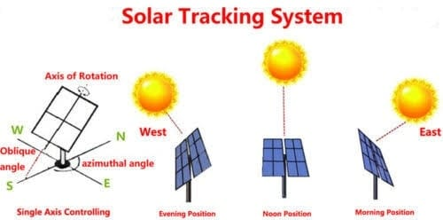
The solution to our problem is Sun Tracking Solar Panel,
It is a solar panel that is equipped with LDR’s(Light Dependent Resistor) and servo motor that help it move with direction of the sun
Which helps increase in the efficiency of the solar panels by about 33%.
Source for efficiency figures- Department of Electrical and Electronics Engineering, Faculty of Engineering, Anadolu University, Eskişehir, Turkey

Slide 5
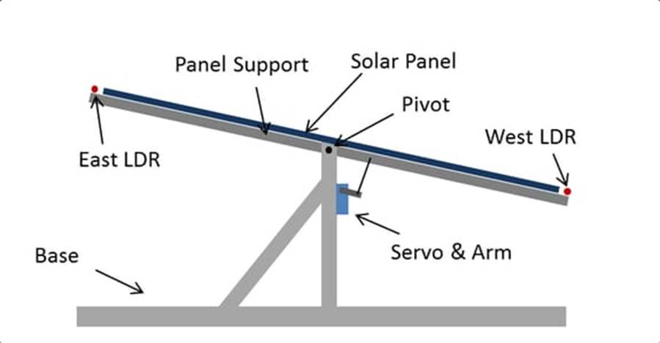
About The Project And It’s Construction
Sun Tracking Solar Panel Works With Help Of LDR(Light Dependent Resistor) That Are Installed On Either Side Of The Panel.
The Servo Motor Helps The Panel Rotate To The Direction Of The Sunlight.
Arduino Communicates With Servo Motor And LDR Sensors Making The Operation Possible.
This Whole Setup Is Completed With Connections With The Help Jumper Wires And Bread Board.
This Whole Setup Is Put together with A Rigid Stand Made By Our Team From Cardboard.

Slide 6
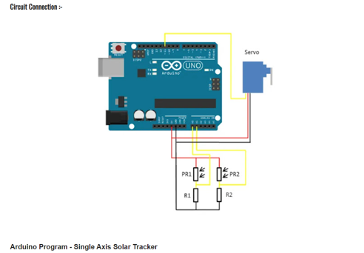
Circuit Diagram

Slide 7
Uses In The Real World
There are plethora of uses for this Technology and I would like to present few them to you :-

Slide 8
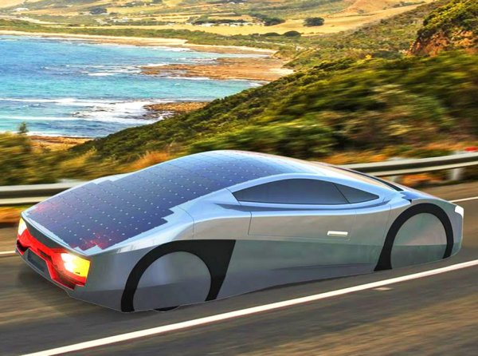
It can be embed on the roof of electric vehicles, which will allow them to maximize their efficiency by moving accordingly to the sun rays with changing direction of the vehicles on the road.
This Photo by Unknown Author is licensed under CC BY-ND

Slide 9
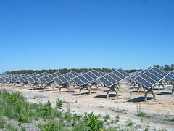
It can be installed on Solar Farms and can increase their efficiency by moving the panel along with rising and setting sun throughout the day cycle.
This Photo by Unknown Author is licensed under CC BY-SA

Slide 10
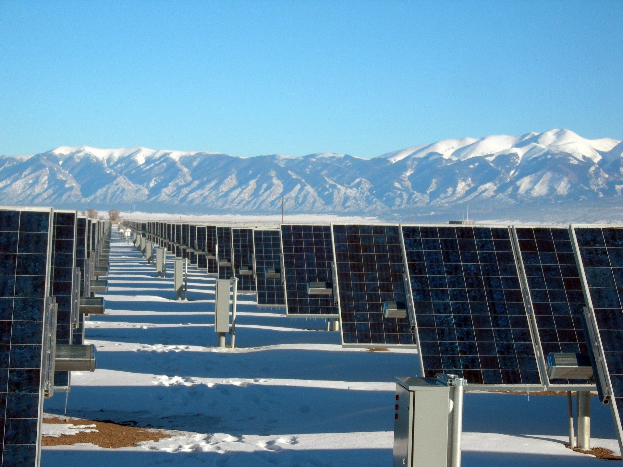
We can use it in remote areas where the exposure to sunlight is very less, And in such conditions the only way we can make using Solar Energy feasible is to equip them with this technology.

Slide 11
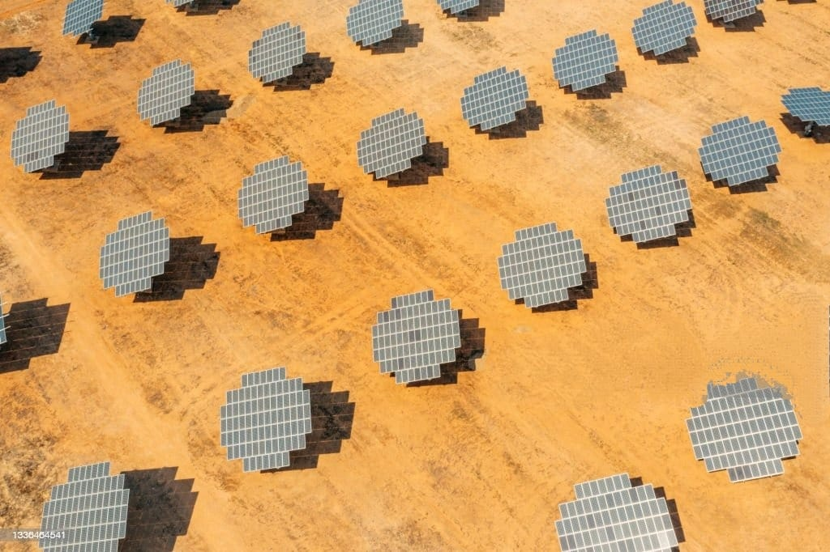
The Future For The Technology
The technology in it’s advanced form can and is developing with 360 degree axis of rotation equipped solar panels, Unlike the single axis of rotation of our solar panels ,
The panels that can rotate in 360 degree’s are more efficient and will be proven to be a wonderful addition to the world with an increasing need for energy.
Unlicensed, Can't be used commercially
Credit:
Justin Paget Creative #:1336464541 Licensed type: Royalty-free Collection: Digital Vision Location: Spain
Release info: No release required

Slide 12
Thank You we hope for a greener and better tomorrow

